Slide 1
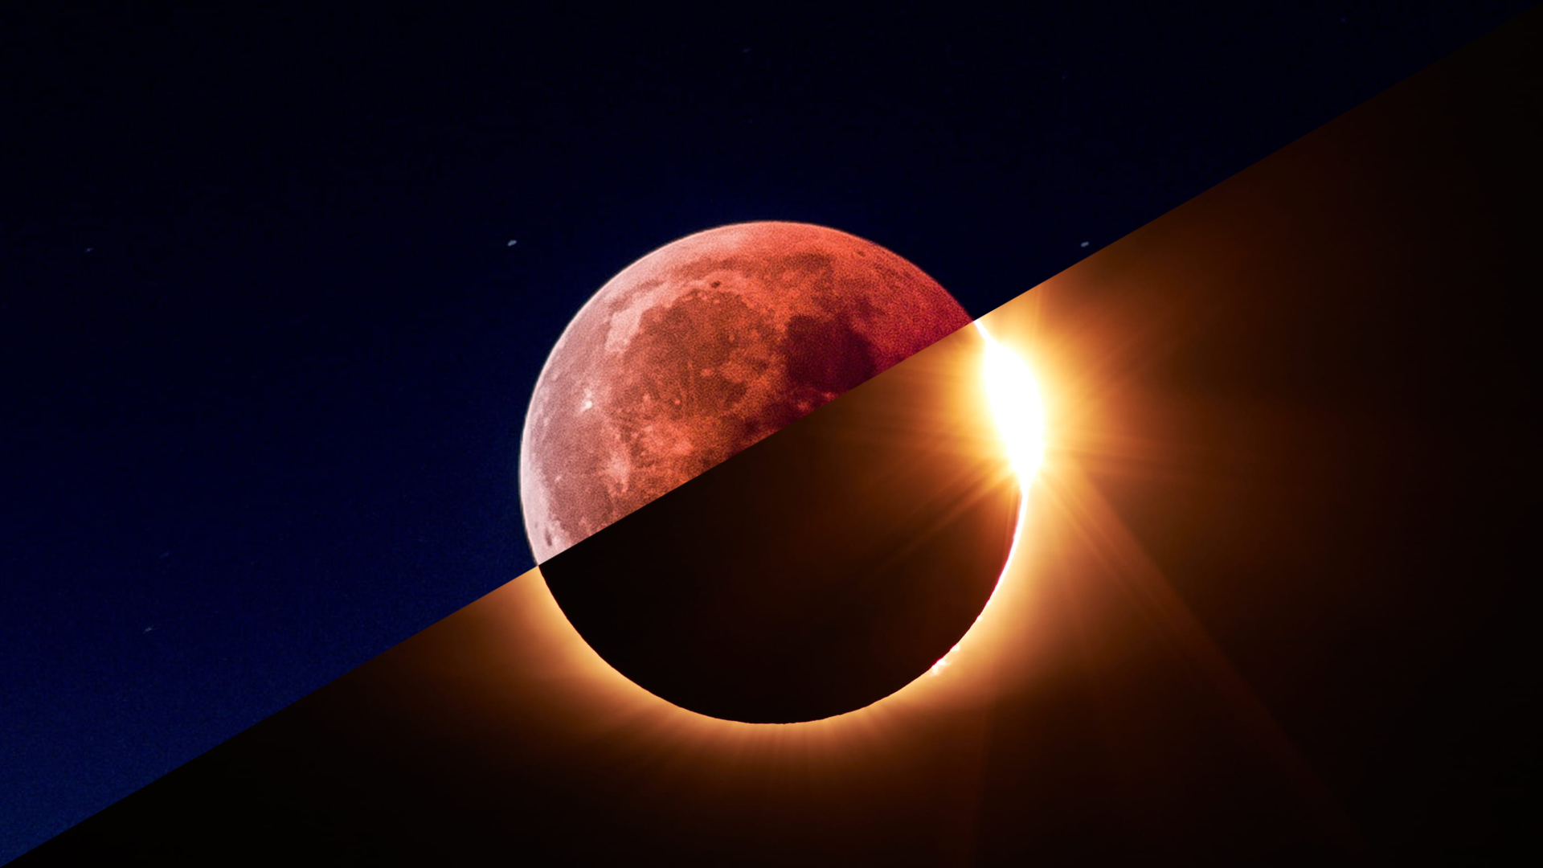
Eclipses: Perspective Is Everything
TEAM: EARTH ALIENS
Latheep maideen A Karan M
Mohamed Irfan A
Aravindkumar D
Balaji S

Slide 2
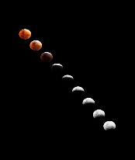
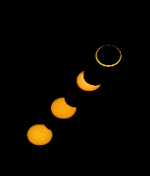
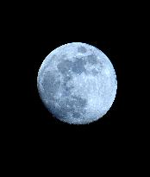
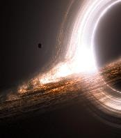
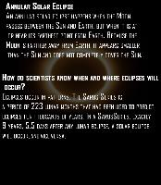
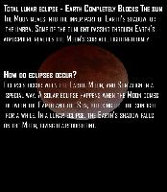
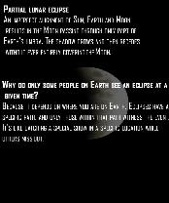
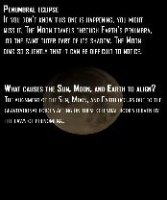
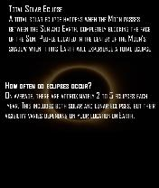
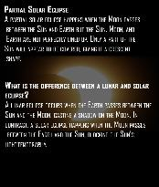
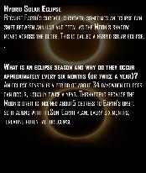
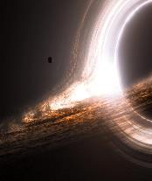
The Game Lunar Or Solar:
Game Cards:
We have created a game called 'The Lunar Or Solar.' This game allows players to understand all concepts of eclipses.
We are go with Game approach because there is inherent enjoyment and engagement make learning more enjoyable and promote sustained attention and participation.
Before playing a Lunar Or Solar one can know about the types of eclipse so the game providing knowledge from scratch.

Slide 3
Game Instructions:
There are two players in the game, and there are 10 cards in total.
Out of the 10 cards, five have pictures of Lunar eclipses, and five have pictures of Solar eclipses on the front side.
On the back side of each card, there is information about different types of Lunar and Solar eclipses, along with some bonus information.
The game starts with one player shuffling the cards and placing them face down.
This player asks the second player, "LUNAR OR SOLAR?“
The second player must choose either "Lunar" or "Solar.“
The first player then asks, "IN LUNAR/SOLAR?" again.
The second player specifies a type of Lunar eclipse and picks a card from the Lunar side.
If the card matches what the second player chose, the player win a point; otherwise, the player lose a point.
The game then switches to the other player, and the process continues.
Special Cards:-
There are two joker cards with a picture of a black hole on the back. If a player picks a joker card, they don't earn any points, and the game moves to the next player.
There is a bonus point card with a picture of a blue moon on the back.If a player picks this card, they earn 1 point.
The first player to reach 10 points wins the game.
Enjoy your
Eclipse-themed
card game!

Slide 4
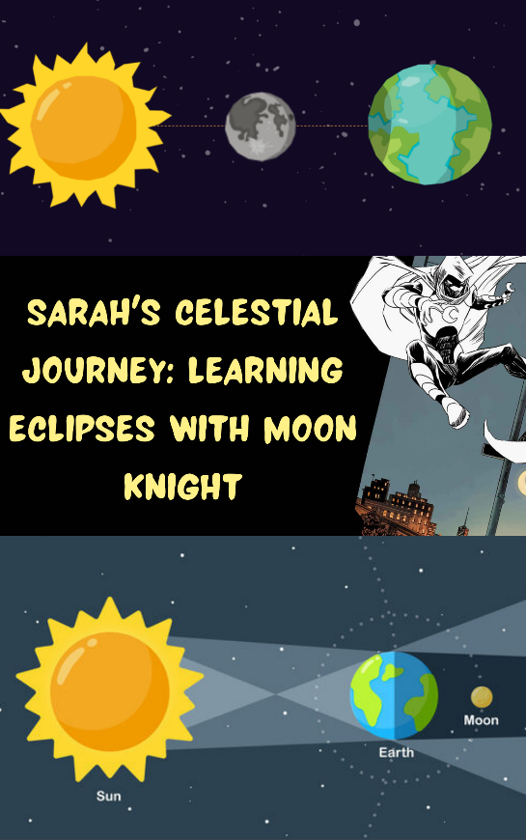
Our Comic Story
Creating a comic story helps make learning easier and more interesting for all learners.
In our story, we have two characters:Sarah: She's a 10-year-old child who has lots of questions and wants to understand things better.
MoonKnight: He's a character from Marvel Comics, and he's here to explain all of Sarah's questions and doubts in the story.
Now, let's explore how MoonKnight helps Sarah learn about eclipses in a simple and engaging way.

Slide 5
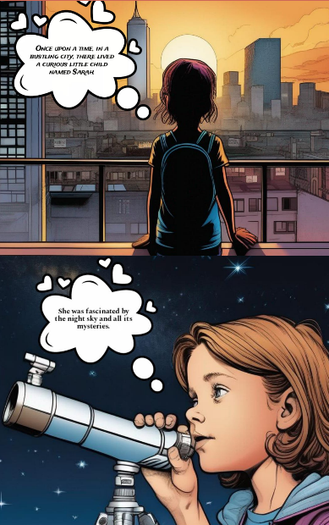
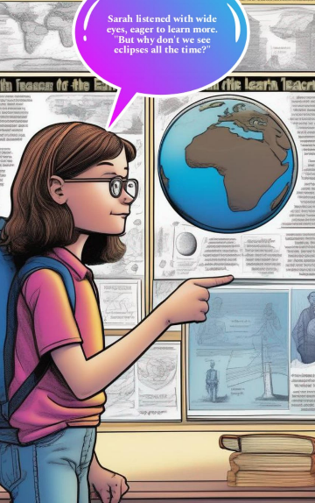
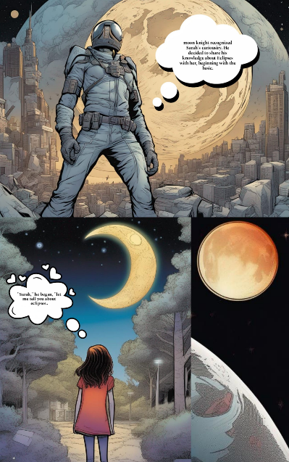
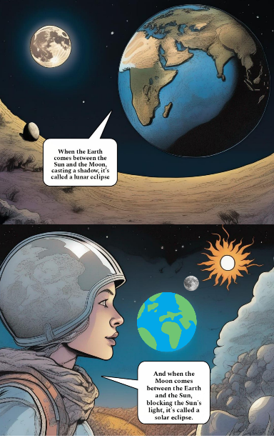
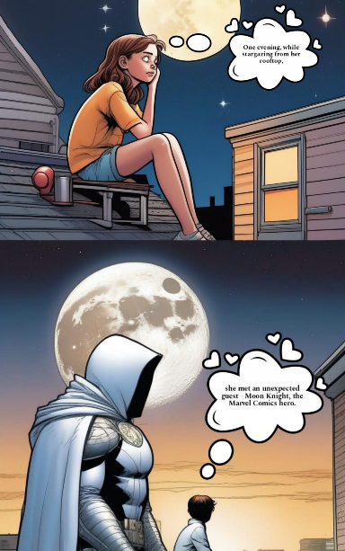

Slide 6
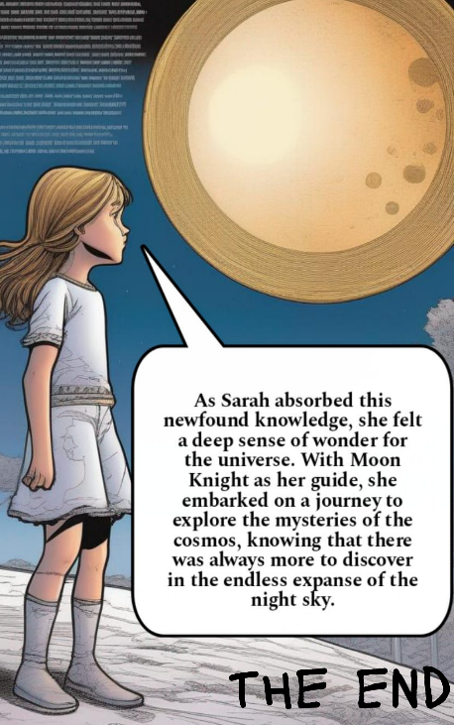
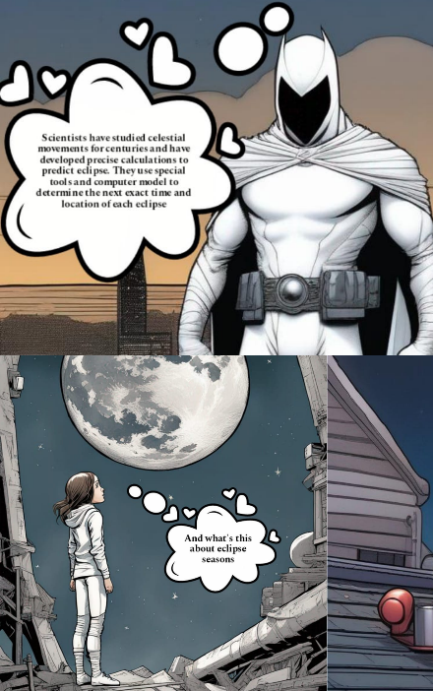
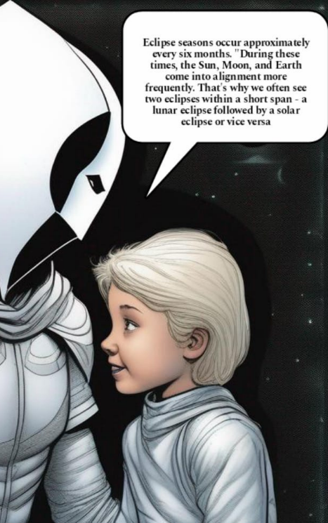
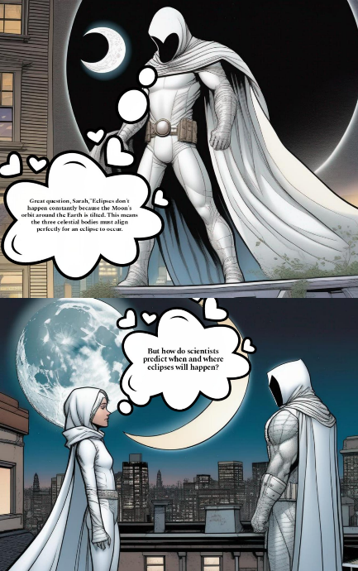
Sarah Celestial Journey

Slide 7
SUMMARY
knowing about eclipses is essential for scientific, cultural, educational, and practical reasons. It enriches our understanding of the universe, its workings, and our place within it.
Explaining eclipses with the help of characters like Moon Knight and Game-Lunar Or Solar makes learning more engaging and simplifies complex ideas.
This approach uses pictures and stories to help you understand eclipses better.

